Slide 1

NoSQL Database Design for E-Commerce Marketplace
This presentation explores the design and implementation of a scalable, cloud-hosted NoSQL database system tailored for e-commerce marketplaces. It highlights the selection of MongoDB Atlas, a distributed document-based database, to manage dynamic data such as product listings, orders, and user accounts with high availability and flexibility.
We will cover technology research, system architecture, deployment, testing, challenges, and future recommendations to optimize performance and scalability in an e-commerce environment.

Slide 2

Technology Research
NoSQL Technologies Considered
Final Technology Choice
MongoDB Atlas selected for ease of use, replication, and integration with Mongoose and Express.
MongoDB: Document-based, flexible schemas
Redis: In-memory, fast but limited querying
Cassandra: Highly scalable, complex management

Slide 3
PROJECT SCOPE AND REQUIREMENTS
Business Requirements
Technical Requirements
Manage product listings and inventory
Distributed cloud-hosted database
Process and track customer orders
Node.js and Express backend
Provide secure user authentication
RESTful API architecture
Scale dynamically with increased usage
MongoDB Atlas as the primary database
Security via authentication roles and IP-based access control

Slide 4

System Architecture and Design Considerations
Architecture Components
Design Strategies
MongoDB Atlas 3-node replica set for high availability
Embedded order documents within user records
Node.js backend with Express framework
Flexible document model for diverse product attributes
Mongoose ODM for schema management
Replication ensures data durability and availability
Optional frontend UI for browsing and orders

Slide 5

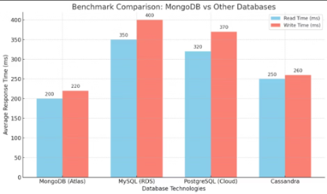
Benchmark Comparison and
75
75
75
Deployment Setup
Security and Cluster Configurations and collections
Cluster on AWS Cape Town, M0 Sandbox tier, 3-node replica set enabled, no sharding in free tier.
Username/password authentication, readWrite roles, IP whitelisting for controlled access.
Benchmark Comparison: MongoDB vs Other Databases

Slide 6

Implementation and Deployment Plan
The MongoDB Atlas cluster was set up on AWS Cape Town using the M0 Sandbox free tier, with a 3-node replica set enabled but no sharding support.
The DBD381-Project database includes products, orders, categories, and users collections, supporting e-commerce operations.
Access is secured via username/password with readWrite roles, and a Mongoose-connected backend ensures schema-driven interaction and future scalability.

Slide 7

Testing Plan and Results
Functionality Testing
Scalability Testing
Performance Evaluation
CRUD operations tested via Postman across all collections
Inserted over 1000 product documents
M0 tier deemed sufficient for development and testing
Verified user authentication and order placement logic
Measured and logged read latency and replication lag
Average API response time: 150–300ms

Slide 8

Challenges Faced and Trade-Off Analysis
Challenges
Pros
Temporary IP whitelisting with 0.0.0.0/0 for group testing; centralized schema file maintained via GitHub.
Quick deployment, flexible schema, built-in replication and high availability.
Cons
Lacks native joins and complex queries; free tier has resource limits; performance spikes under heavy load.

Slide 9

Conclusions and Recommendations
Key Findings
MongoDB Atlas meets flexibility, availability, and performance needs for e-commerce backends.
Indexing on searchable fields improves user experience and reduces bounce rates.
Optimization Recommendations
Upgrade to paid tiers for production performance
Implement indexing and full-text search with Atlas Search
Enable automated backups for data safety

Slide 10
Future Research and Deployment Guide
Future Applications
Deployment Guide Highlights
Machine learning for personalized recommendations
Prerequisites: Node.js, MongoDB Atlas account, Git
Real-time analytics dashboards via MongoDB aggregation
Steps: Clone repo, npm install, configure .env, start server, test with Postman
Complementary tools like Redis or ElasticSearch for enhanced performance
Includes backend code snippets and Postman collections

Slide 11
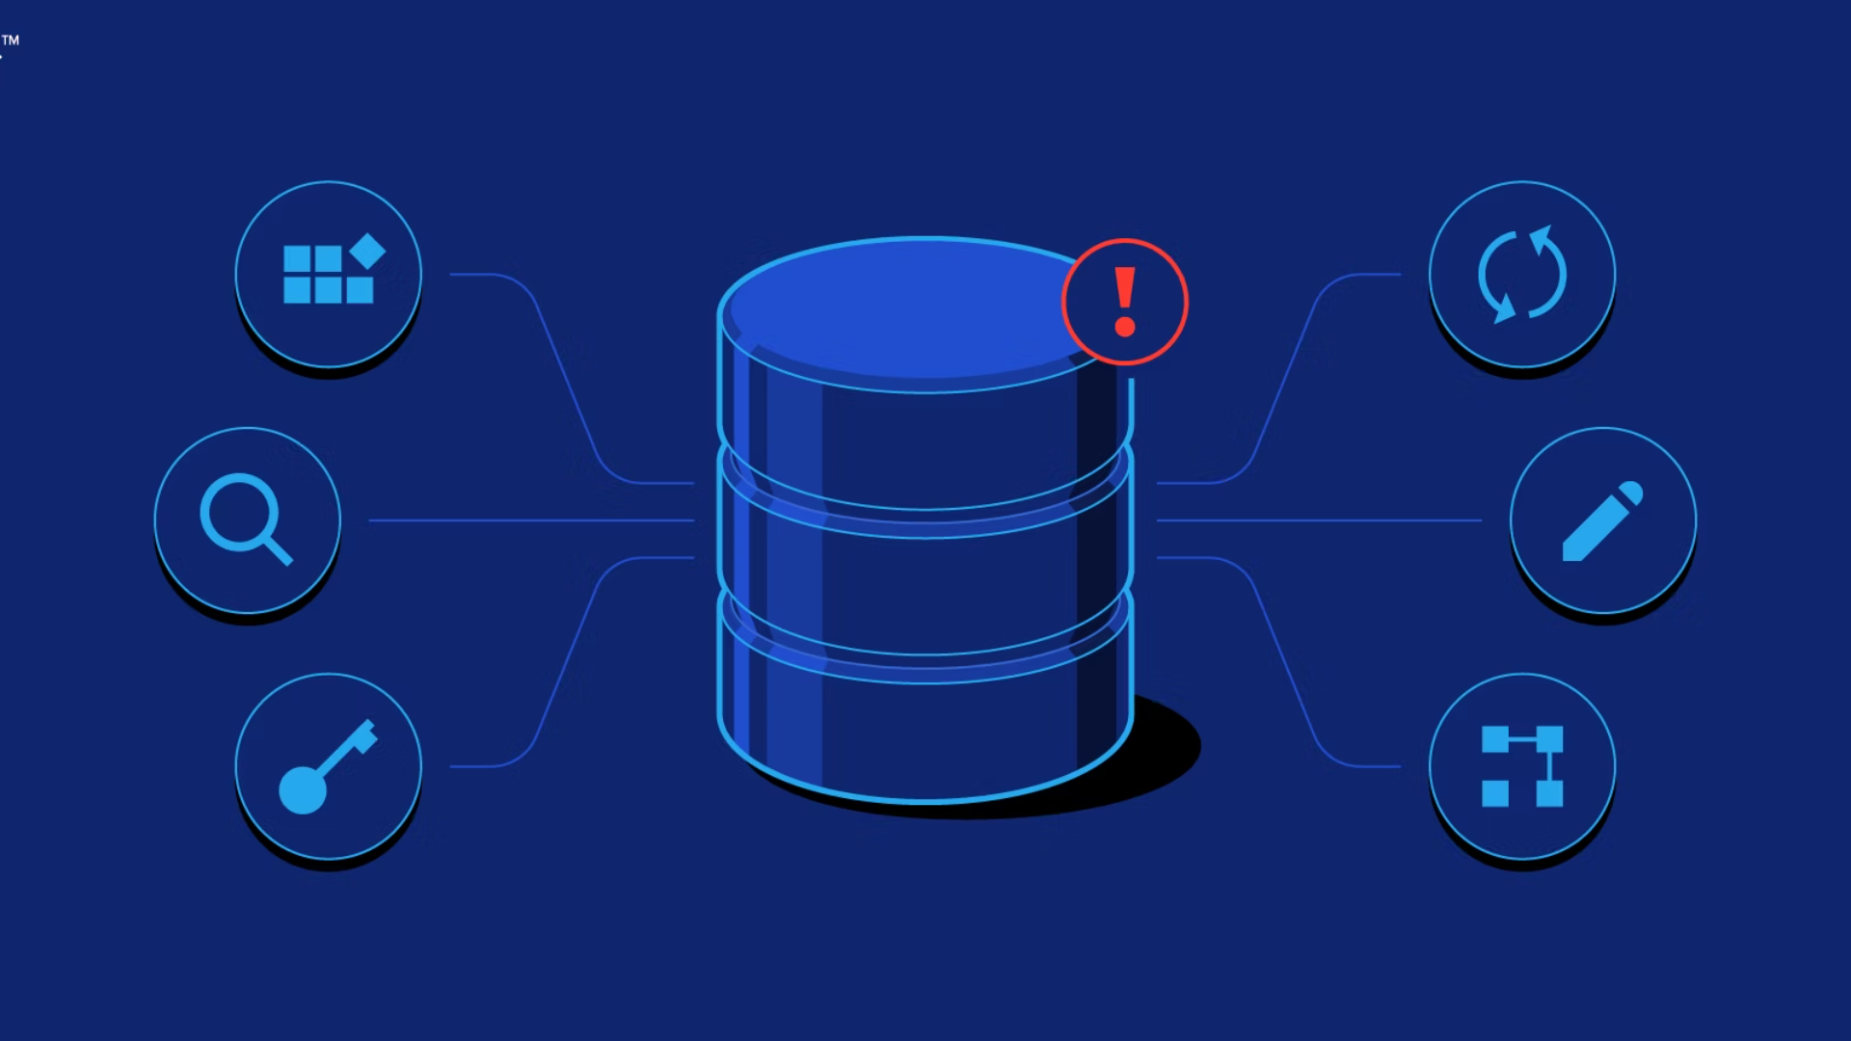
Live Demo Show

Slide 12

Thank you

